Slide 1
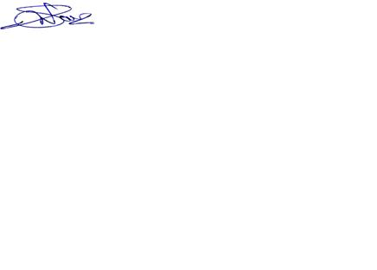
NEWSLETTER
A newsletter brought to you by Satish Injectoplast pvt. Ltd.
Vol. 1, Issue 1.
January 2017
MD’s Message :
It is not only the product performance but also the engineering and support which differentiate us from
competition. Our ability to work with key customers through a partnership approach from the start of
a program is a strong value proposition that we will continue to develop and leverage. Our philosophy of
working closely with the end customers whether directly or indirectly are rewarding us with preferred
status. Our system and solution approach helps our customers to a single point responsibility in us. We thank
our customers for showing confidence in our knowledge and supporting product offering. As an organization
we have and will continue to invest for the future.
Let us work together towards the objective of “Make in India” .
Yours,
Shrikant Navandar
Our Vision / Mission
Vision :
To Delight our Customers by providing one point solutions in plastic products through our Creativity, Capability & Manufacturing excellence.
Mission :
Achieving turnover of INR 300 Cr by FY 2020-21.
To Achieve Customer Satisfaction 90%.
To Diversify into various Plastic Technology such as blow moulding, Plastic Welding, 2K Moulding.
Improving Employee Satisfaction @ 3% Y-O-Y by building skills &competency, people engagement,
training programs, rewards-recognitions and CSR involvement.
Min. 10% share of sales growth through direct export of products.
To Start our own product designing and R&D center.

Slide 2
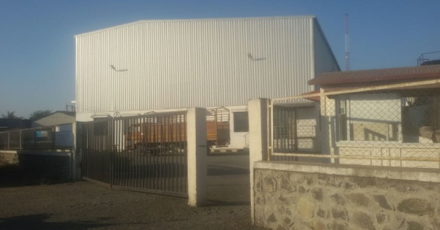
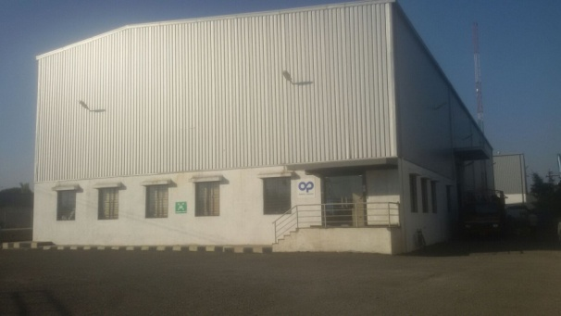
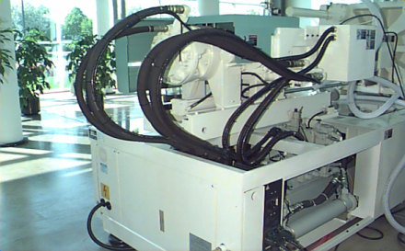
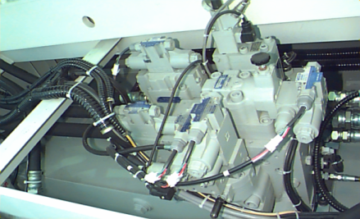
OUR NEW JOURNEY TOWARDS VISION
New Expansions :
Unit III , Nasik – EOU
Facility spread over 28000 sq. ft.
2 nos Molding Machines
Unit IV, Chakan, Pune :
Facility spread over 35000 sq. ft.
11 nos Molding Machines
NEW TECHNOLOGY
We have upgraded ourselves with new technology by investing in Electric Injection Molding machine which will become operational from First week of April’16 . This is a new concept for us which will bring many benefits such as Energy saving, low water consumption, Lower operating cost, No oil, Operator benefits etc.
ACHIVEMENT OF SATISH
Satish Injectoplast has received Award of Excellence by IAC International Automotive for “Launch and Development Support” in January 2016.
MD, Mr. Shrikant Navandar and Business Head, Mr. Maniesh Sharrma
receiving the award

Slide 3
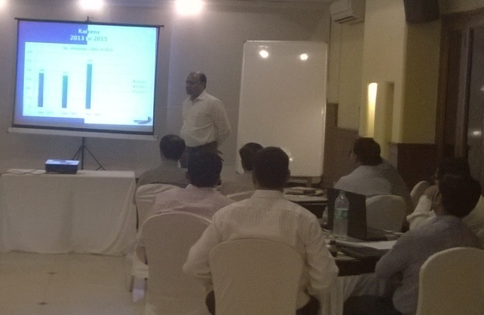
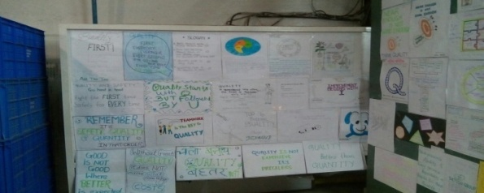
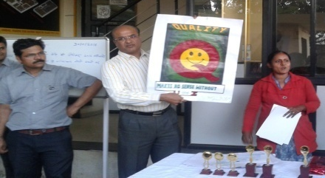
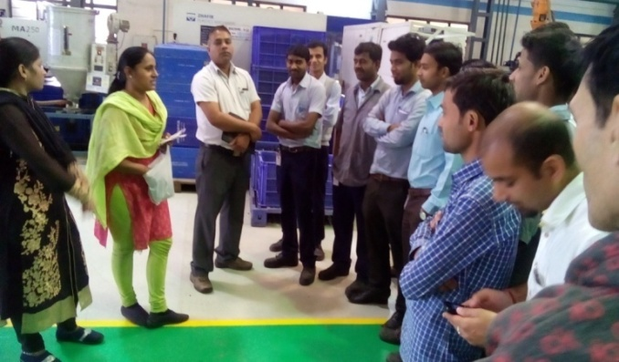
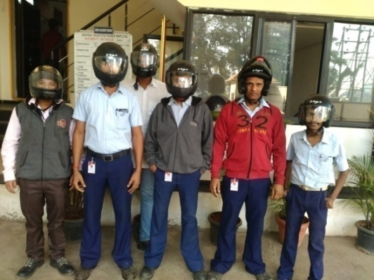
ANNUAL BUSINESS MEETING
Annual Business meeting with our key personnel's
was conducted on January 27, 2017 at Hotel Seven Haven Hotel, Nashik.
MD shared business plan to internal stake holders
& Review on Business score card was presented.
EVENTS & ACTIVITIES @ SATISH
Quality week celebration - Employee commitment for quality through slogan competition, Poster competition and Quiz competition during Quality week Dec 01, 2016.
We care for our Employees
Safety Helmet made compulsory.

Slide 4
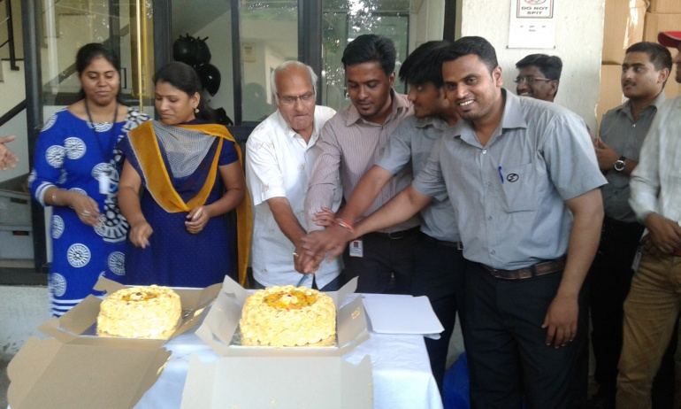
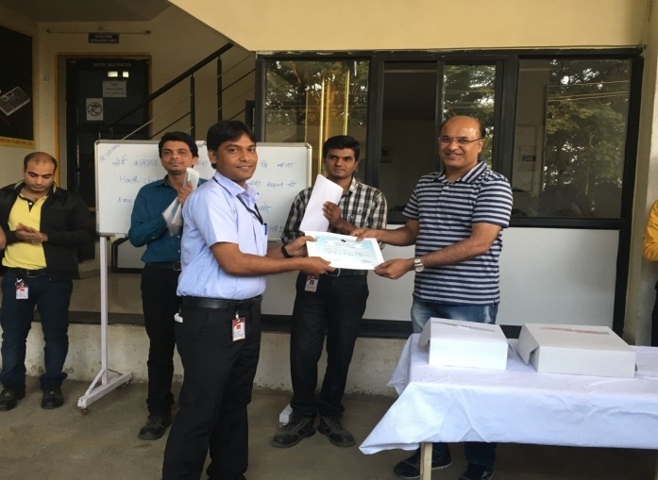
Hall of Fame @ SATISH
A small function is held on the first Sunday of every month wherein a cake is cut by all employees whose birthday falls in the current month.
Birthday Celebration on January 08, 2017
Monthly Star Performer Awards :
We are proud of our employees who contribute their idea’s & are engaged towards company growth.
The award is given in following categories - Best Operator, Best Setter, Best Kaizen , Innovative idea’s , Best suggestions , punctual, Best 5s & safety zone , Zero Lot rejection, Best support.
MD, Mr. Shrikant Navandar awarding the Best Operator during Monthly Award ceremony held on January 08, 2017
Satish Injecto Plast PVt. Ltd.
info@satishinjecto.com
G-53, AMBAD MIDC,
Nasik, Maharastra
India.

